Slide 1



Applied Data Analysis (CS401)
Lecture 2
Handling data
23 Sep 2020
Robert West
Notes:
Overall, 8 minutes too long
2-3 min of tech difficulties in the beginning
“Dirty data horror stories”: told only CHF 10k anecdote
Skipped Willy slide
Gave quick version of reCAPTCHA slide
Part 1 took exactly 45 min (incl. tech difficulties in the beginning), did break then

Slide 2
Announcements
Register your teams (3 people) here by Wed 30 Sep
Each team member must individually complete form!
Project milestone P0 to be released this Fri 25 Sep, due on Fri 2 Oct
Friday’s lab session:
Intro to Pandas (very important for Homework 1 and rest of course)

Slide 3
Feedback
Give us feedback on this lecture here: https://go.epfl.ch/ada2020-lec2-feedback
Feedback form available for each lecture and lab session
What did you (not) like about this lecture?
What was (not) well explained?
On what would you like more (fewer) details?
Is it nicer to follow the lecture online or offline?
…

Slide 4
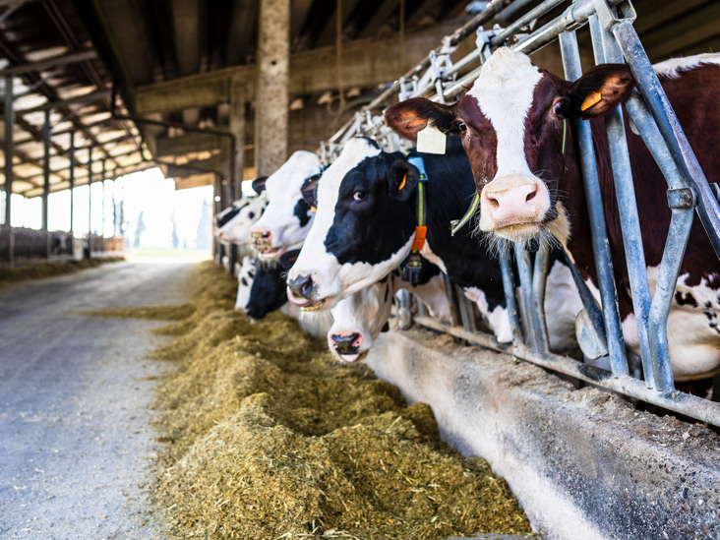
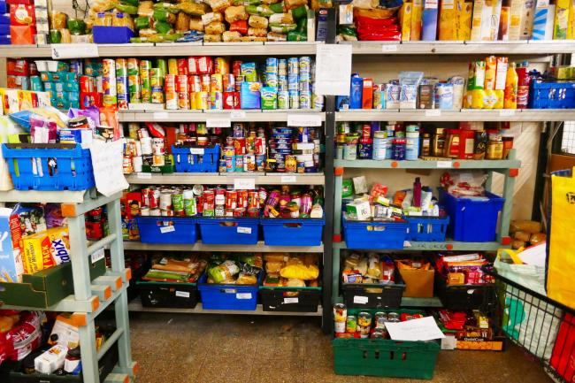
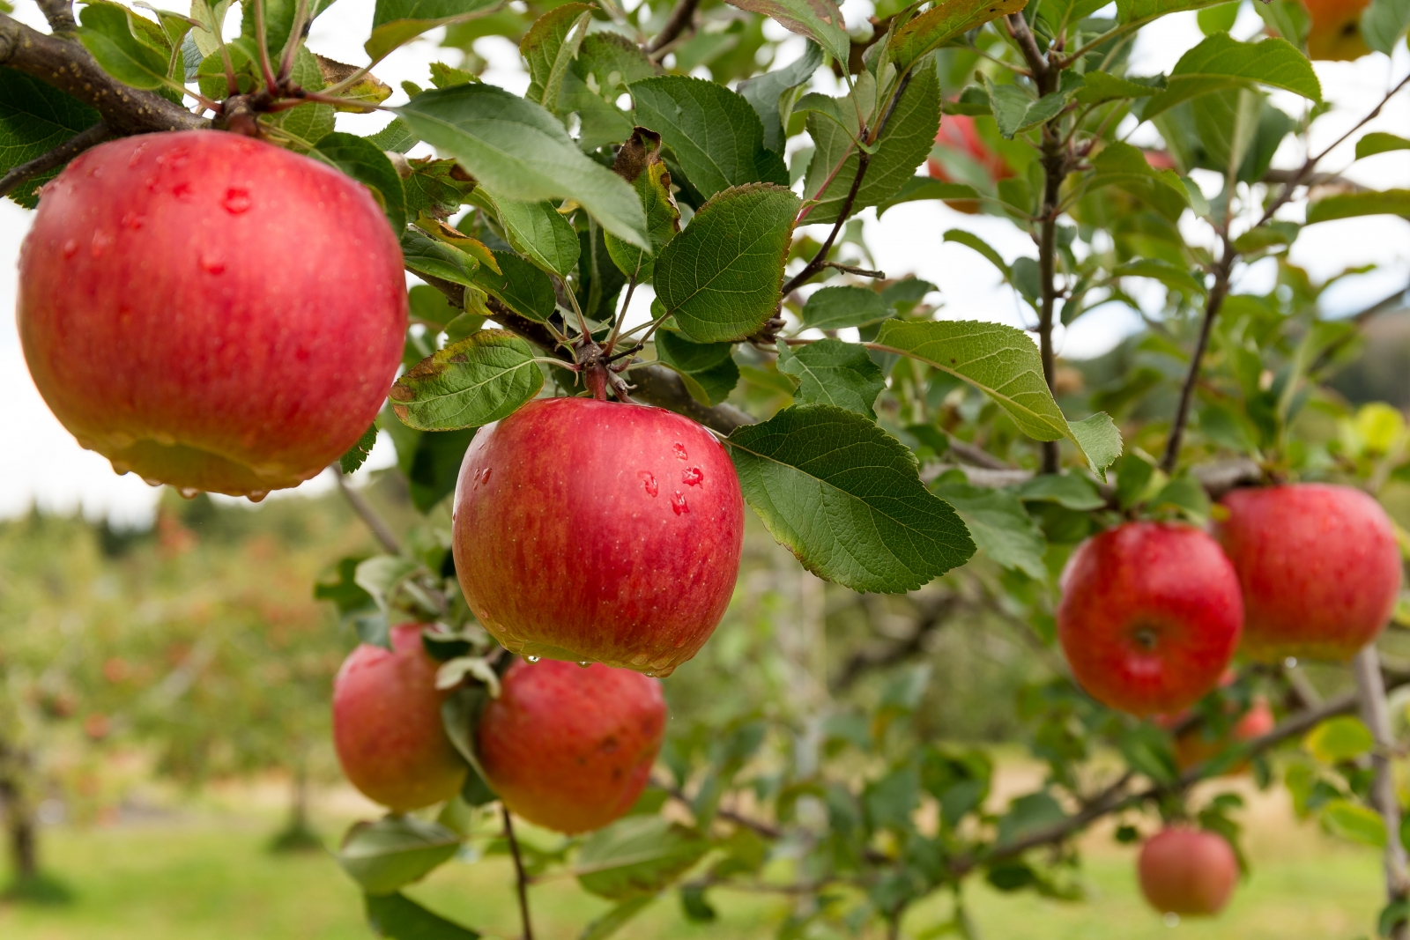
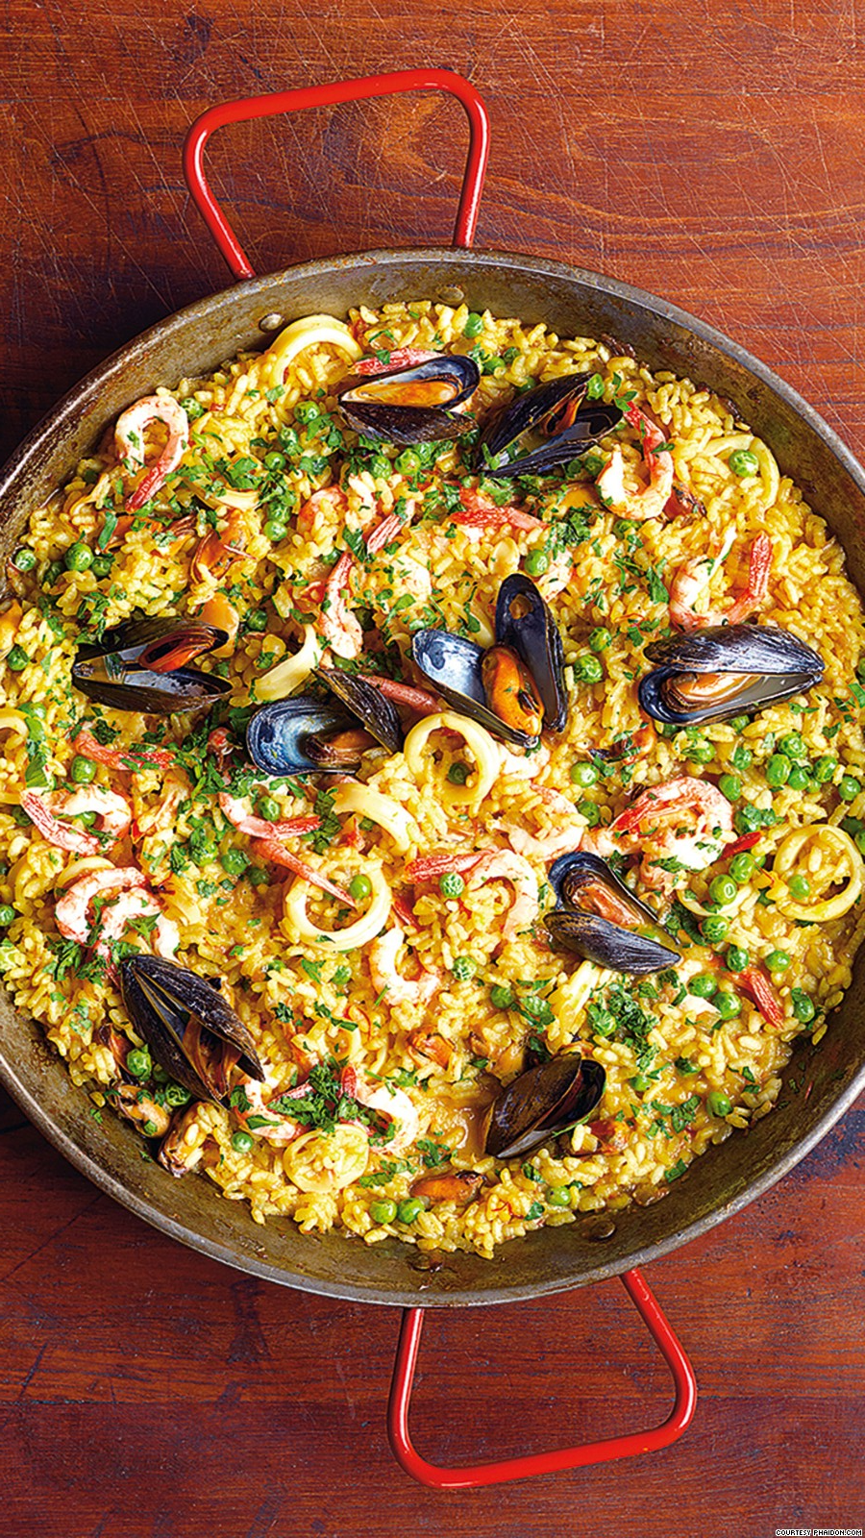
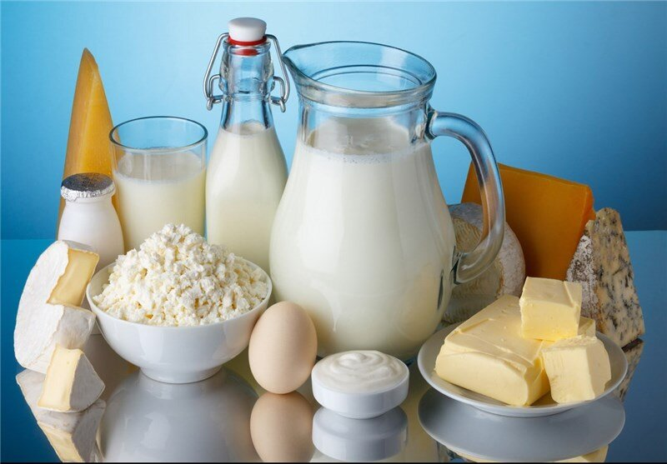
Cooking with data
Part 2:
Data sources
Part 1:
Data models
Part 3:
Data wrangling

Slide 5
Cooking with data
Part 2:
Data sources
Part 1:
Data models
Part 3:
Data wrangling

Slide 6
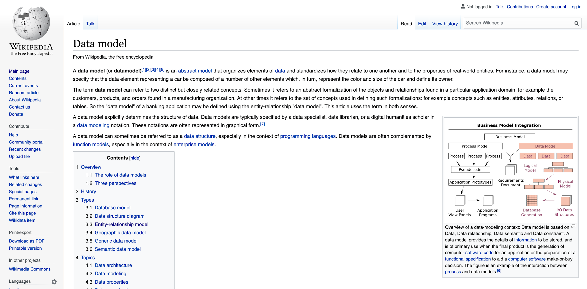
Bob’s definition: A data model specifies how you think about the world

Slide 7
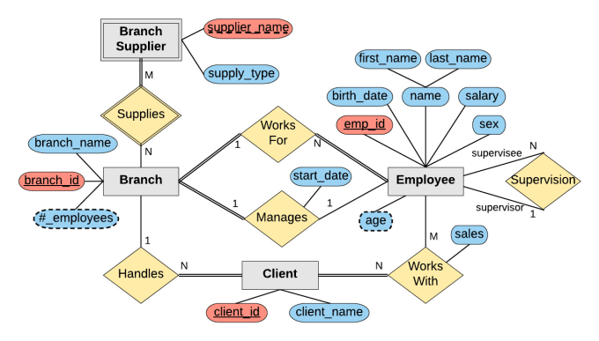
Q: “How do you think about the world?”
A: “See my entity–relationship diagram!”
How to store my data on a computer?
entity
Part 1:
Data models
relationship
attributes
Notes:
A reminder from your DB class (prereq for ADA)
Gray rectangles: entities
Yellow rhombi: relationships (with cardinalities)
Blue/red pills: attributes (for both entities and relationships; red: keys)

Slide 8
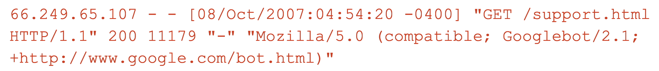
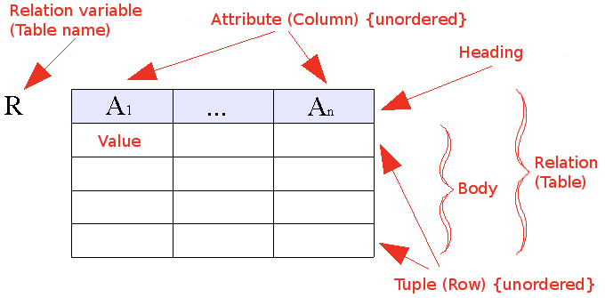
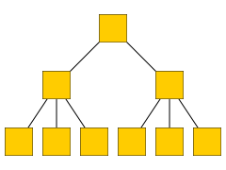
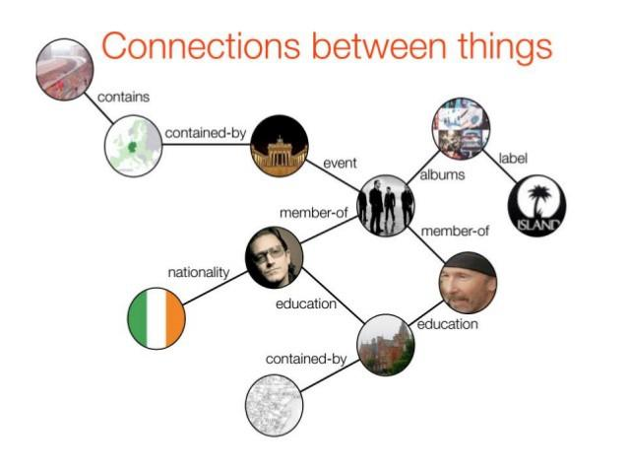
Q1: “How should I store my data on a computer?”
Q2: “How do I think about the world?”
“The world is simple: one type of entity, all with the same attributes” → Flat model
“The world contains many types of entities, connected by relationships” → Relational model
“The world is a hierarchy of entities” → Document model
“The world is a complex network of entities” → Network model
Notes:
They are equivalent, can represent any dataset in any model
But processing the data is vastly simplified by representing the data in the most appropriate model

Slide 9
Flat model
Example: log files; e.g., Apache web server (httpd)
Entities = requests from clients to server
66.249.65.107 - - [08/Oct/2007:04:54:20 -0400] "GET /support.html HTTP/1.1" 200 11179 "-" "Mozilla/5.0 (compatible; Googlebot/2.1; +http://www.google.com/bot.html)"
111.111.111.111 - - [08/Oct/2007:11:17:55 -0400] "GET / HTTP/1.1" 200 10801 "http://www.google.com/search?q=in+love+with+ada+lovelace+what+to+do&ie=utf-8&oe=utf-8&aq=t&rls=org.mozilla:en-US:official&client=firefox-a" "Mozilla/5.0 (Windows; U; Windows NT 5.2; en-US; rv:1.8.1.7) Gecko/20070914 Firefox/2.0.0.7"
Another common format: CSV (“comma-separated vector”)
Notes:
“d” in “httpd” for “daemon”
Not a real DB (no schema, no consistency), although it looks temptingly like one
~ benevolently formatted plain text

Slide 10
Q1: “How should I store my data on a computer?”
Q2: “How do I think about the world?”
“The world is simple: one type of entity, all with the same attributes” → Flat model
“The world contains many types of entities, connected by relationships” → Relational model
“The world is a hierarchy of entities” → Document model
“The world is a complex network of entities” → Network model

Slide 11
Relational model
“The world contains many types of entities, connected by relationships”
The relational model is ubiquitous:
MySQL, PostgreSQL, Oracle, DB2, SQLite, …
You use it many times every day
Data represented as tables (“relations”) describing
entities,
relationships between entities
Most of the data we will use can be “reduced” to the relational model
id | name
1 | Bush
2 | Trump
3 | Obama
president | successor
1 | 3
3 | 2
Notes:
(you’re supposed to know this as a prereq)

Slide 12
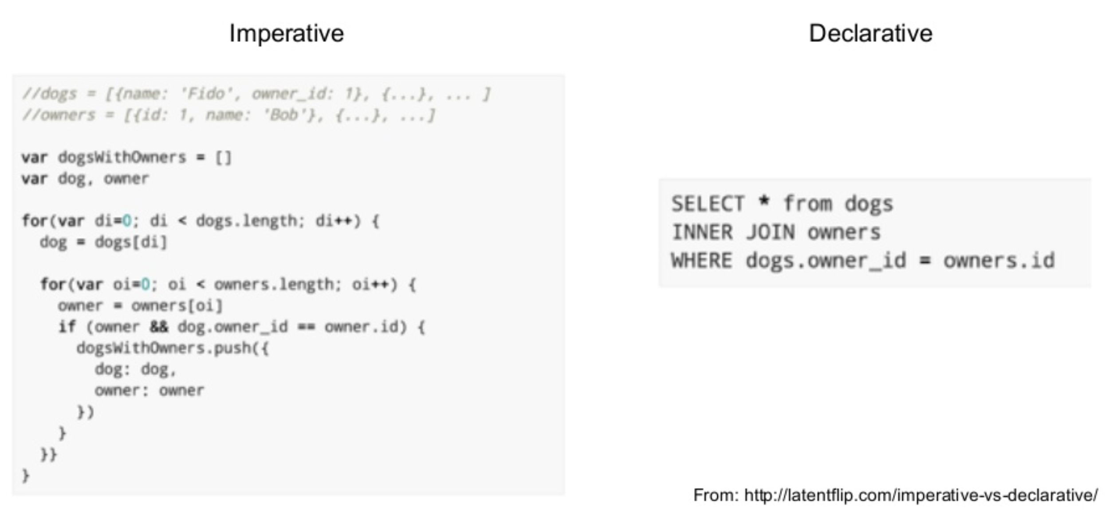
Processing data in the relational model: SQL
Declarative language for core data manipulations
You think about what you want, not how to compute it
Notes:
SQL = structured query language
The interface for doing stuff with relational data
Extremely rich language; a lot of fun to puzzle together massive queries

Slide 13
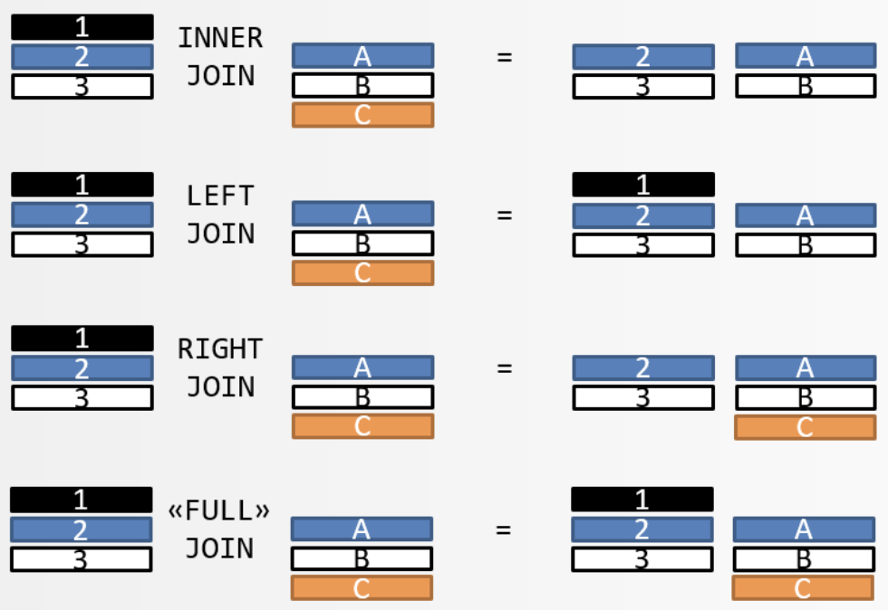
SQL
We expect you to know SQL (basics of DBs a class prerequisite)
Need a refresher? → Watch/do online tutorials!
Key concepts:
Select (!), update, delete
Unique keys
Joins (inner, left outer, right outer, full)
Sorting
Aggregation (group by, count, min, max, avg, etc.)
Notes:
POLL: Have you worked with SQL joins?

Slide 14
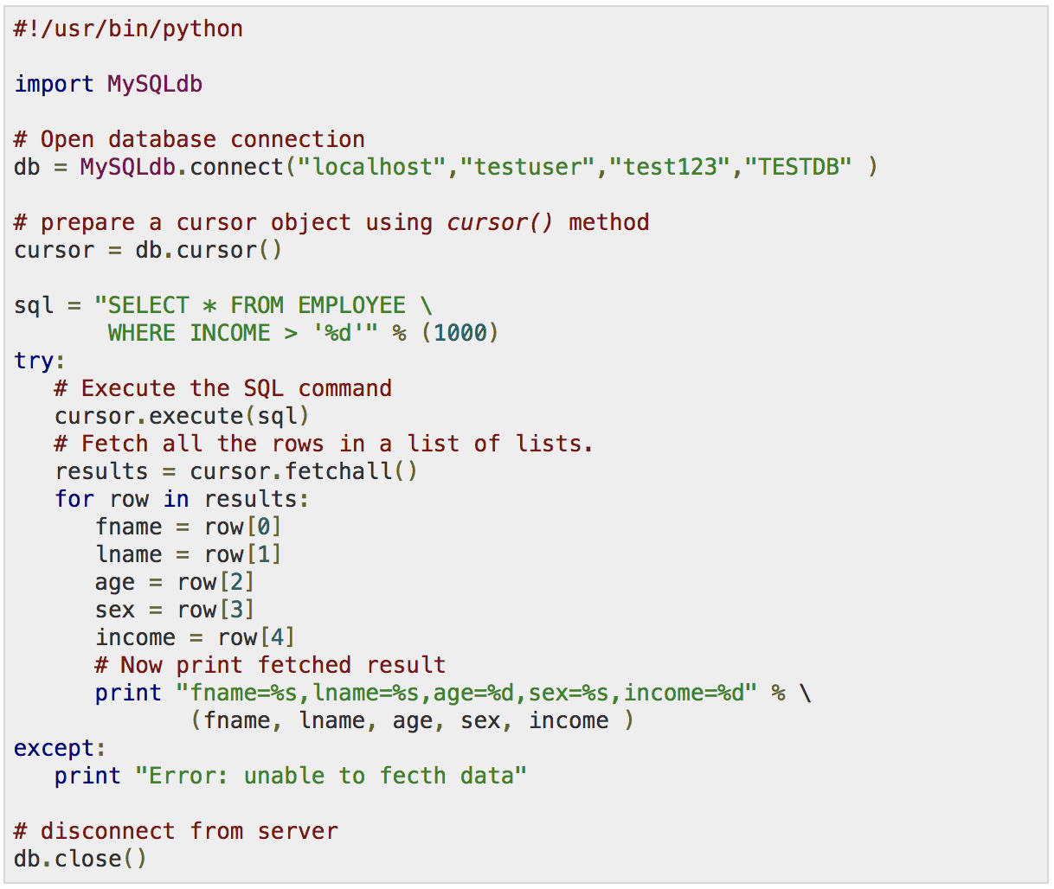


SQL implementations
etc.
Notes:
There are command line clients and GUIs
but often most convenient: call from another PL (e.g., Python)

Slide 15
SQL and “SQL”
The declarative-programming principles of SQL are widespread, even where it’s less obvious

Slide 16
“SQL”: Pandas (Python library)
Similar to SQL (declarative), with additional elements of functional programming (map(), filter(), etc.)
SQL “table” ←→ Pandas “DataFrame”
Need intro? Come to Friday’s lab session!

Slide 17
Pandas vs. SQL
+ Pandas is lightweight and fast.
+ Natively Python, i.e., full SQL expressiveness plus the expressiveness of Python, especially for function evaluation.
+ Integration with plotting functions like Matplotlib.
- In Pandas, tables must fit into memory.
- No post-load indexing functionality: indices are built when a table is created.
- No transactions, journaling, etc. (matters for parallel applications)
- Large, complex joins are slower.

Slide 18
“SQL”: Unix command line
cat users.txt \
| awk ‘$2 >= 18 && $2 <= 25’ \
| join -1 1 -2 1 pages.txt - \
| cut -f 4 \
| sort \
| uniq -c \
| sort -k 1,1 -n -r \
| head -n 5
Notes:
Don’t underestimate its power
It works on Macs
Free afternoon? Read a tutorial

Slide 19
Q1: “How should I store my data on a computer?”
Q2: “How do I think about the world?”
“The world is simple: one type of entity, all with the same attributes” → Flat model
“The world contains many types of entities, connected by relationships” → Relational model
“The world is a hierarchy of entities” → Document model
“The world is a complex network of entities” → Network model

Slide 20
Document model
contact
address
“The world is a hierarchy of entities”
street,
city,
country
XML format:
JSON format:
<contact> <id>656</id> <firstname>Chuck</firstname> <lastname>Smith</lastname> <phone>(123) 555-0178</phone> <phone>(890) 555-0133</phone> <address> <street>Rue de l’Ale 8</street> <city>Lausanne</city> <zip>1007</zip> <country>CH</country> </address> </contact>
contact: { id: 656, firstname: “Chuck”, lastname: “Smith”, phones: [“(123) 555-0178”, “(890) 555-0133”], address: { street: “Rue de l’Ale 8”, city: “Lausanne”, zip: 1007, country: “CH” } }
Notes:
Both formats equivalent
JSON usually easier to read for humans
XML: nested tags
JSON: set of key/value pairs
Keys: strings
Values:
Leaves: primitive types: strings, number, boolean
JSON object (recursive! → tree), e.g., “address”
Arrays of JSON objects (or strings/numbers/booleans)

Slide 21

CHAT ROULETTE!
Think for 1 minute:
If we want to use a relational DB (e.g., MySQL)
instead of XML, how can we store
2 phone numbers for the same person?
Then: chat with a fellow student for 3 minutes
Rolex Forum: Talk to neighbor (priority: left, right)
Zoom: You’ll be randomized into small “breakout rooms”
Document model
<contact> <id>656</id> <firstname>Chuck</firstname> <lastname>Smith</lastname> <phone>(123) 555-0178</phone> <phone>(890) 555-0133</phone> <address> <street>Rue de l’Ale 8</street> <city>Lausanne</city> <zip>1007</zip> <country>CH</country> </address> </contact>

Slide 22
Solution to chat roulette puzzle
Document model
Same in relational model
<contact> <id>656</id> <firstname>Chuck</firstname> <lastname>Smith</lastname> <phone>(123) 555-0178</phone> <phone>(890) 555-0133</phone> <address> <street>Rue de l’Ale 8</street> <city>Lausanne</city> <zip>1007</zip> <country>CH</country> </address> </contact>
id | first name | ...
656 | Chuck | ...
... | ... | ...
id | phone
656 | (123) 555-0178
656 | (890) 555-0133
... | ...
Notes:
Relational: same entity may be spread across tables
doc model: all together
by allowing for repetitions, whereas in relational model, we can’t have a variable #cols
Different models are better suited for different kinds of processing
E.g., updating easier in doc model, since not spread out
Relationships between different entities more easily expressed in relational model (surprise…)

Slide 23
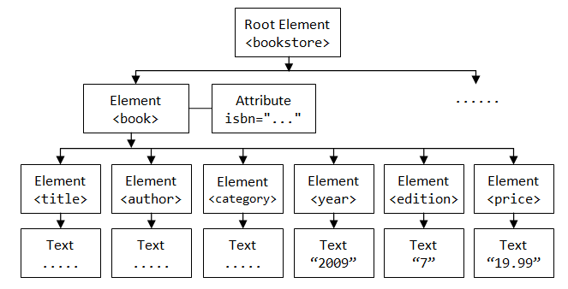
Processing XML and JSON
Document structure = tree
Processing via tree traversal (depth- or breadth-first search)
Or use proper query language, such as implemented by jq

Slide 24
Q1: “How should I store my data on a computer?”
Q2: “How do I think about the world?”
“The world is simple: one type of entity, all with the same attributes” → Flat model
“The world contains many types of entities, connected by relationships” → Relational model
“The world is a hierarchy of entities” → Document model
“The world is a complex network of entities” → Network model

Slide 25
Network model
“The world is a complex network of entities”
Notes:
Model =~ how you think about the world
Models data as vertices and edges
Could also be written as tables as in relational model
But network model additionally comes with query language that lets you succinctly express graph relations
E.g., find path between Ireland and Island Records
(impossible in SQL)
We’ll see example later (Wikidata KG)

Slide 26
“How should I store my data on a computer?”
—A word (or two) on binary formats
Binary format often the key to performance, avoiding expensive parsing
Modern binary formats support nested structures, various levels of schema enforcement, compression, etc.
Python pickle, Java Serializable, Protocol Buffers (Google), Avro (supports schema evolution), Parquet (column-oriented), etc.
→ Consider converting to a binary format at the beginning of your processing pipeline (especially when using “big data”)

Slide 27
Cooking with data
Part 2:
Data sources
Part 1:
Data models
Part 3:
Data wrangling

Slide 28
Data sources at Web companies
Examples from Facebook
Application databases
Web server logs
Event logs
API server logs
Ad server logs
Search server logs
Advertisement landing page content
Wikipedia
Images and video
Structured data (with clear schema)
Semi-structured data
(“self-describing” structure; CSV etc.)
Unstructured data
Notes:
(Order: structured → unstructured → semi-structured)
DB: constraints between tables, so everything is always nicely consistent
Cooking analogy: If you can go and pick ingredients from someone else’s shelves, or buy them in the store → great!
Much of the work done already by others
But when combining multiple sources, need to harmonize format → need to think about data models again
Sometimes need to go get your own data from the wild, unstructured world (→ we’ll quickly cover HTML scraping as an example)

Slide 29

Another example: Wikipedia
200+ languages
Over 50 million entities
Mind-boggling richness of data

Slide 30
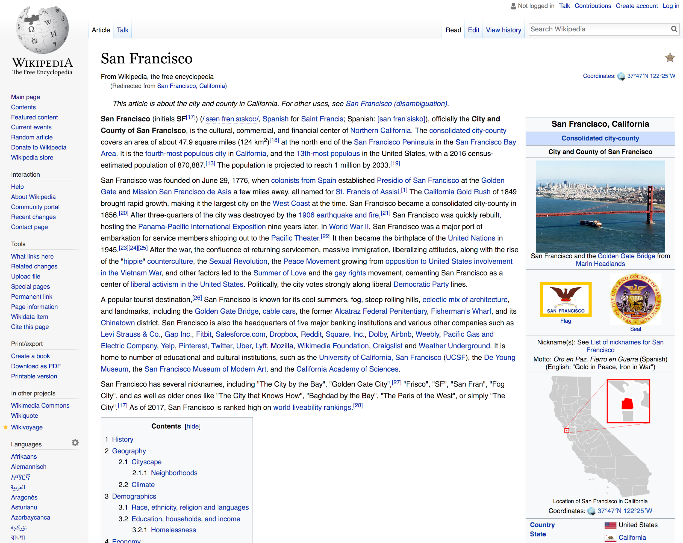
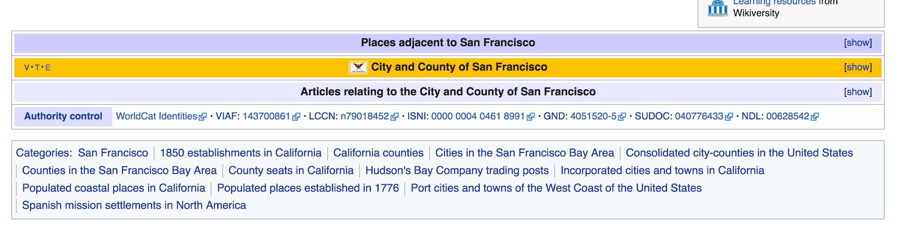
link

Slide 31
Wikipedia
How to work with Wikipedia?
XML dumps with wiki markup, SQL database dumps
Issues: Unicode, size, recency, etc.
To make your life easier:
Find projects on GitHub to help you
Use more structured versions (p.t.o.)

Slide 32
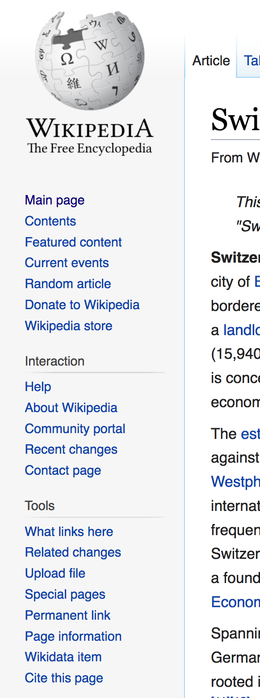
Wikidata
“Database version” of Wikipedia
{fr:Suisse, de:Schweiz, it:Svizzera, en:Switzerland, …} → Q39
Both API access and full database dumps
Available as
JSON (document model)
RDF (network model)

Slide 33
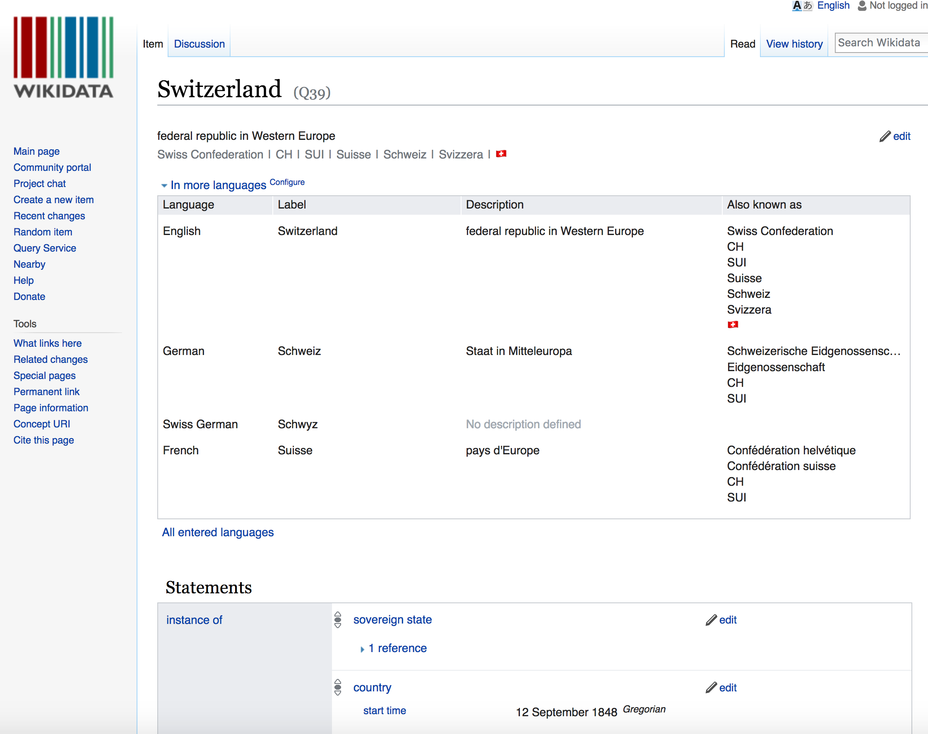

Notes:
“Also known as”
Screenshot is HTML page
Here no need to bother about this fact, since info from page is available in much more easy-to-handle formats, e.g., JSON
(CLICK)
Not always the case: sometimes you need to bite the bullet and do “open-heart surgery” on raw HTML content

Slide 34
Crawling and processing webpages: HTML
Plenty of bulk-downloadable HTML data:
Common Crawl dataset, about 1.82 billion web pages -- huge!
(… but less than 0.1% of Google’s Web crawl, as of 2015)
145 TB, hosted on Amazon S3, also available for download
… but if you need a specific website: use a crawler/“spider”: Apache Nutch, Storm, Heritrix 3, Scrapy, etc. (or simply wget…)
Notes:
(please don’t download to ADA cluster…)

Slide 35
Useful HTML tools
Requests http://docs.python-requests.org/en/master/
An elegant and simple HTTP library for Python
Scrapy https://scrapy.org/
An open-source framework to build Web crawlers
Beautiful Soup http://www.crummy.com/software/BeautifulSoup/ A Python API for handling real HTML
Plain ol’ /regular/expres*ion/s…

Slide 36
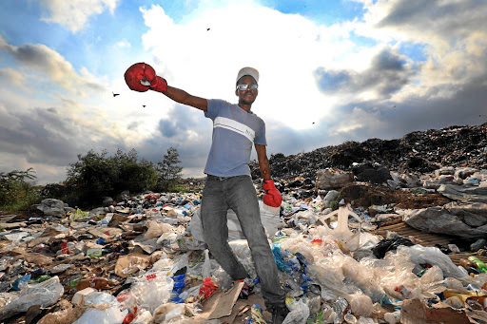
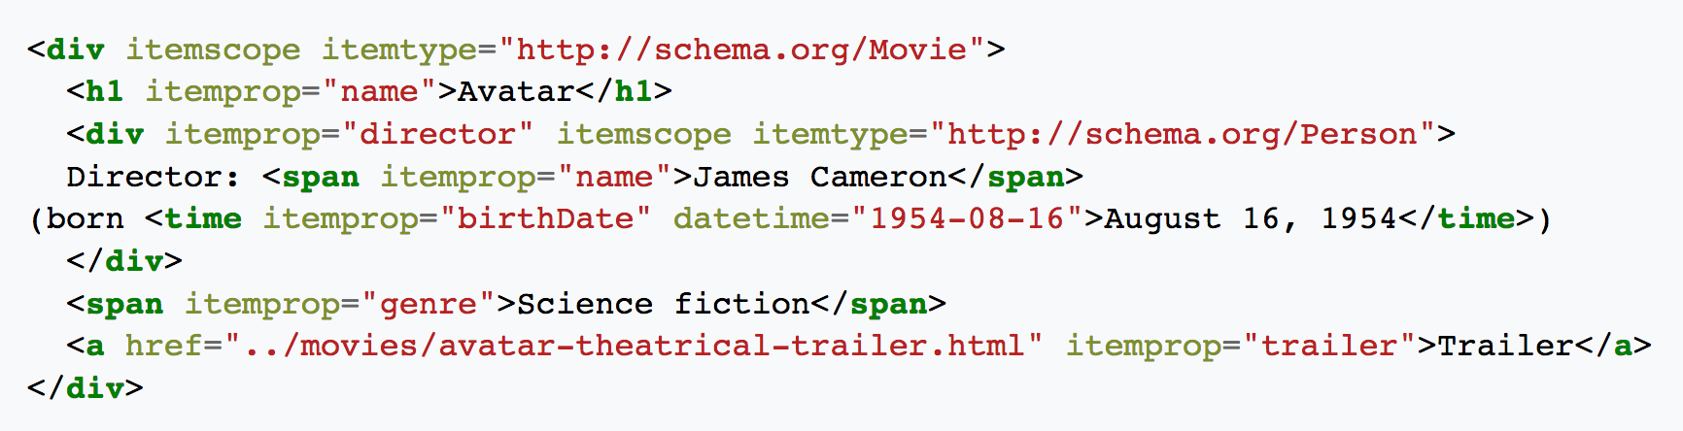
Schema.org: microformats for Web pages
Nuggets of structured information embedded in (semantically) unstructured HTML
Notes:
“Sometimes you can find amazing things in the trash”

Slide 37
Web services
Most large web sites today actively discourage screen-scraping to get their content
Instead: Web service APIs, for interoperable machine-to-machine interaction over a network
The preferred way to get data from online sources
Most common framework: REST
You request a URL from the server via HTTP
The server responds with a text file (e.g., JSON, XML, plain text)
Notes:
But a man gotta do what a man gotta do…

Slide 38
REST example
{
"user": {
"name": "Jane",
"gender": "female",
"location": {
"href": "http://www.example.org/us/ny/new_york",
"text": "New York"
}
}
}
← This resource is a description of a user named Jane
Requested by sending GET request for the resource’s URL, e.g., via curl: curl http://www.example.org/users/jane/
If they need to modify the resource, they GET it, modify it, and PUT it back
The href to the location resource allows savvy clients to get more information with another simple GET request
Implication: Clients cannot be too “thin”; need to understand resource formats!

Slide 39
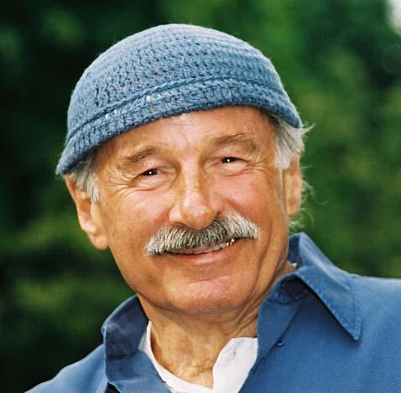

Joe Zawinul
I said, “What’s that?” and he said, “That’s jazz.” “How do you write that?” And he spelt it out. Somehow I saw my name in there, and I liked this word.
Robert West
I said, “What’s that?” and he said, “That’s REST.” “How do you write that?” And he spelt it out. Somehow I saw my name in there, and I liked this word.

Slide 40
Cooking with data
Part 2:
Data sources
Part 1:
Data models
Part 3:
Data wrangling

Slide 41
Working with raw data sucks
Data comes in all shapes and sizes – CSV files, PDFs, SQL dumps, .jpg, …
Different files have different formatting – Empty string or space instead of NULL, extra header rows, character encoding, …
“Dirty” data – Unwanted anomalies, duplicates

Slide 42
Raw data without thinking:
A recipe for disaster!
Notes:
(to stay within the cooking analogy)

Slide 43
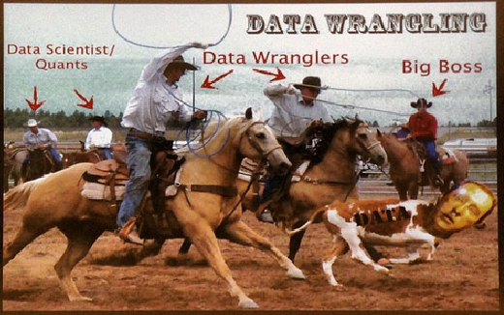
What is data wrangling?
Goal: extract and standardize the raw data
Combine multiple data sources
Clean data anomalies
Strategy: Combine automation with interactive visualizations to aid in cleaning
Outcome: Improve efficiency and scale of data importing
Notes:
“Checks and balances”:
Automation to save you time and effort
Viz to see that you didn’t screw up

Slide 44
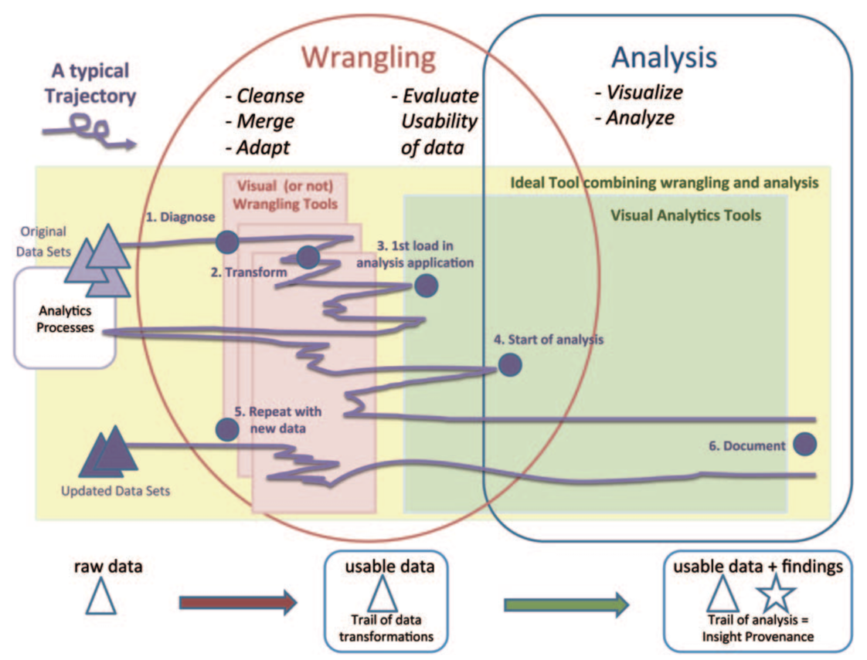
Wrangling takes between 50% and 80% of your time…
[Source]
Notes:
Horrible plot to put in words
-- but that’s exactly the point
it’s extremely ad-hoc
there’s no perfect recipe
Need to use common sense!

Slide 45


Types of data problems
Missing data
Incorrect data
Inconsistent representations of the same data
About 75% of data problems require human intervention (e.g., experts, crowdsourcing, etc.)
Tradeoff between cleaning data vs. over-sanitizing data
link

Slide 46

“Dirty data” horror stories
“Dear Idiot” letter
17,000 men are pregnant
As the crow flies
CHF 10,000 compute-cluster bill
[Source]
Notes:
“For your own perusal at home”
Just tell CHF 10,000 anecdote?

Slide 47
Diagnosing data problems
Visualizations and basic stats can convey issues in “raw” data
Different representations highlight different types of issues:
Outliers often stand out in the right kind of plot
Missing data will cause gaps or zero values in the right kind of plot
Becomes increasingly difficult as data gets larger
Sampling to the rescue!
Notes:
HW1!

Slide 48
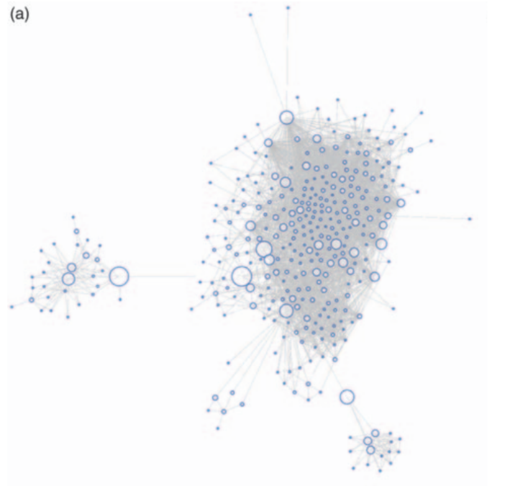
Facebook graph

Slide 49
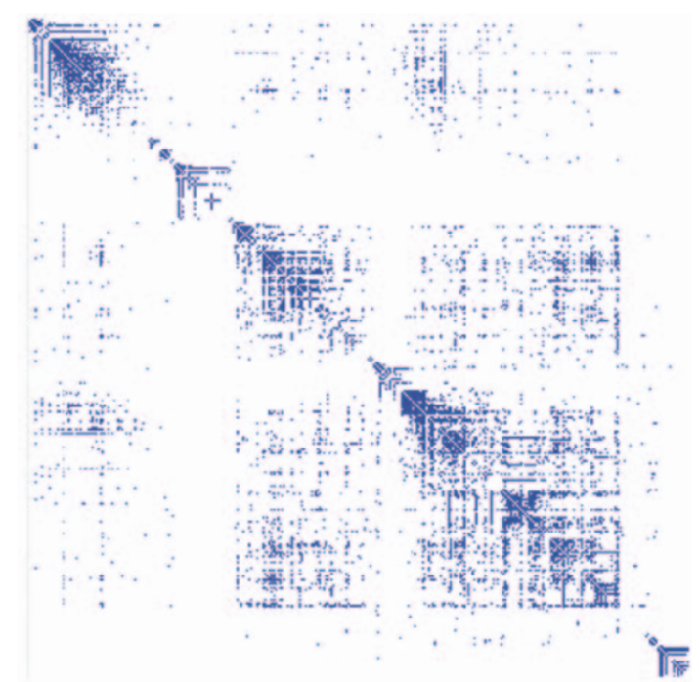
Matrix view (1)
Automatic permutation of rows and columns to highlight patterns of connectivity
Notes:
Explain rows and columns
Ask: why is the matrix symmetric?

Slide 50
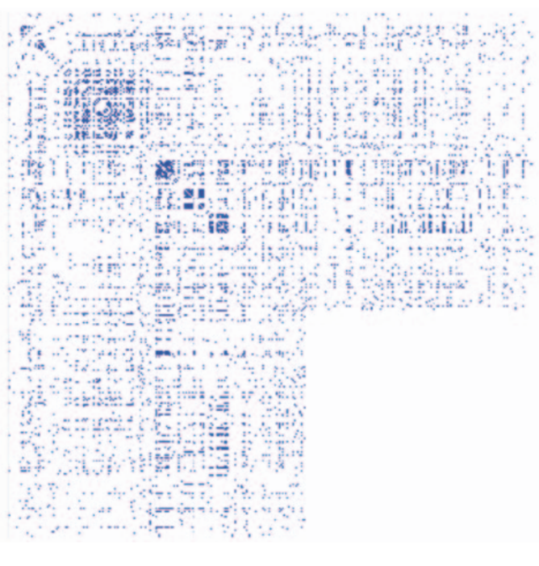
Matrix view (2)
Rows and columns sorted in the order in which data was retrieved via the Facebook API
Can you guess what’s going on here?
Notes:
More info: http://vis.stanford.edu/files/2011-DataWrangling-IVJ.pdf

Slide 51
CHAT ROULETTE!
Think for 1 minute:
What causes the white block in the adjacency matrix?
Then: chat with a fellow student for 3 minutes
Rolex Forum: Talk to neighbor (priority: left, right)
Zoom: You’ll be randomized into small “breakout rooms”
Notes:
Then: share

Slide 52
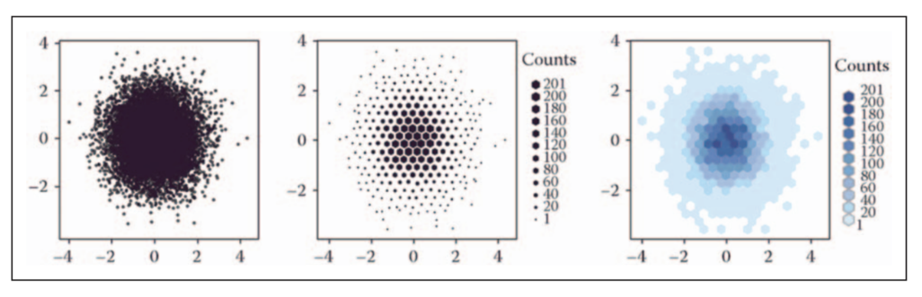
Viz at scale? Careful!
Notes:
Hexagon vs. square
Color discontinuity: makes outlier spotting easier (no problem with middle plot here)

Slide 53
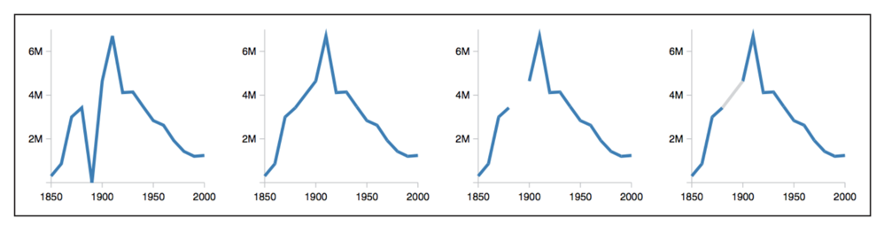
Dealing with missing data
U.S. census counts of people working as ‘‘farm laborers’’; values from 1890 are missing due to records being burned in a fire
Set values to zero?
Interpolate based on existing data?
Omit missing data?
Knowledge about domain and data collection should drive your choice!

Slide 54
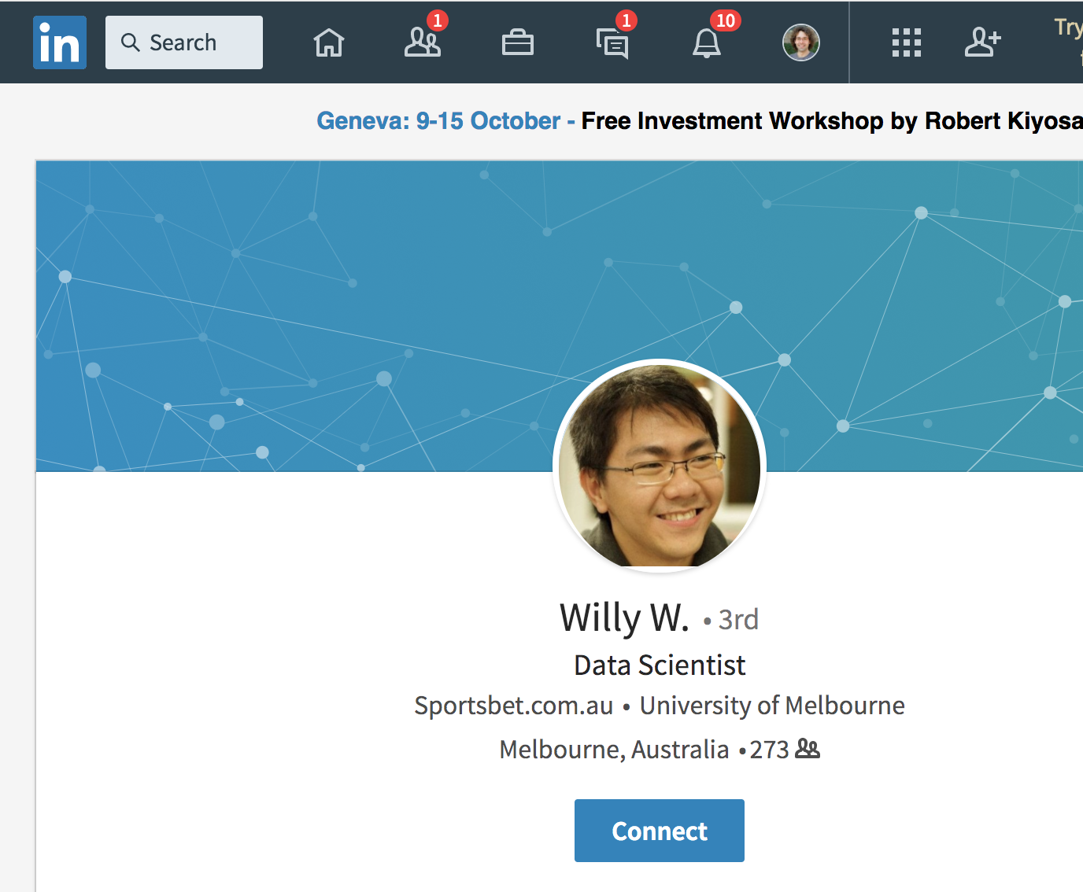
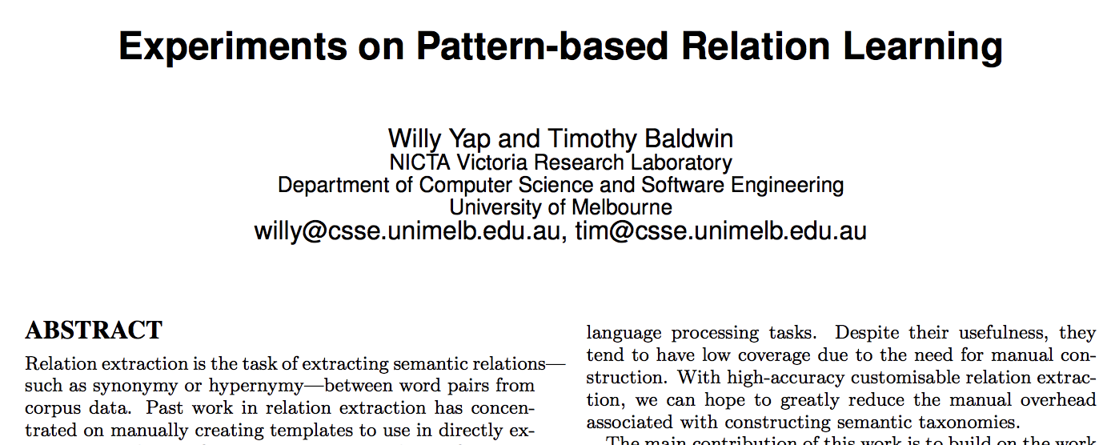
Inconsistent data: “My name is Willy”
First name | Last name
Willy | NULL
... | ...
Notes:
I’m amazed how I even managed to find Willy via Google when making these slides
Luckily, Uni Melbourne is ok with first names for email addresses

Slide 55
Before you start analyzing your data
“Do I have missing data?” “If data were missing, how could I know?”
“Do I have corrupted data?” (May arise from measurement errors, wrong sampling strategies, etc.)
Parse/transform data into appropriate format for your specific analysis (see “Part 1: Data models”)
Don’t be surprised if you need to come back to this stage!
Notes:
This slide might be a “duh” moment, but people often forget these steps!

Slide 56
Desiderata
It’s always ideal if you can put your hands on the code/documentation about the dataset you are analyzing (provenance)
It’s always ideal if the provided data format is nicely parseable (otherwise you need regexes, or maybe even pay humans)

Slide 57
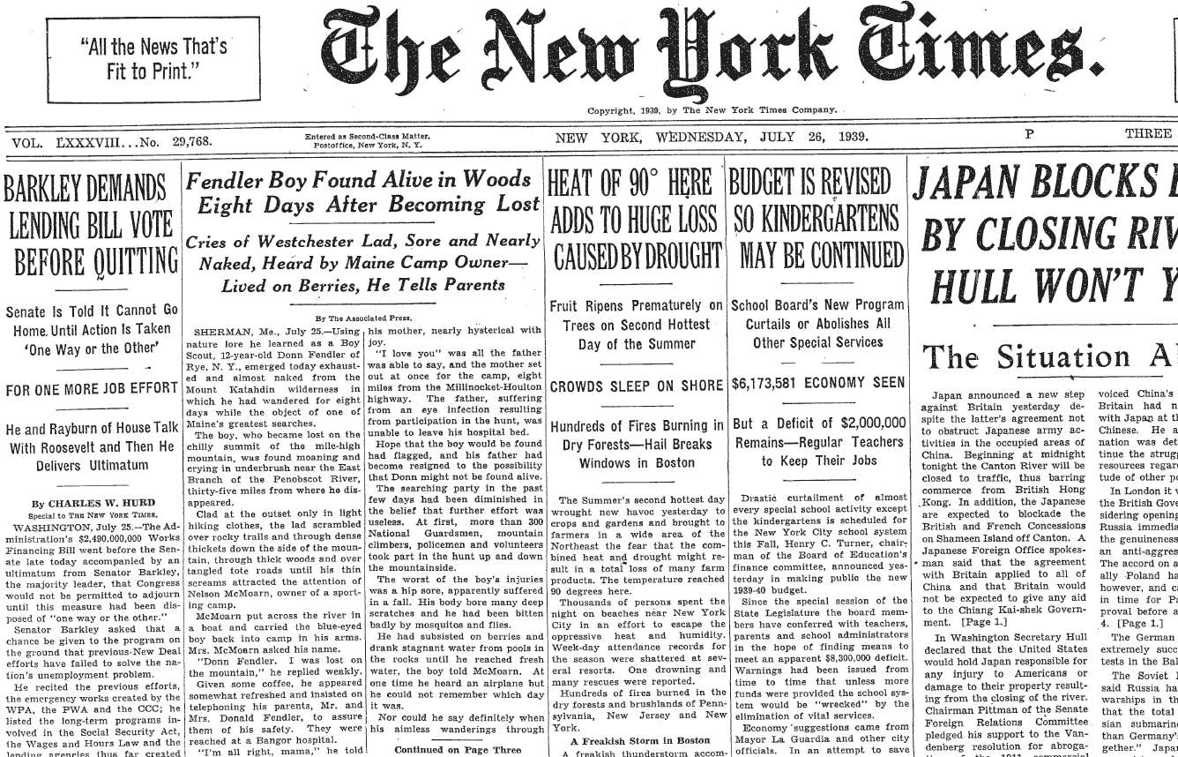
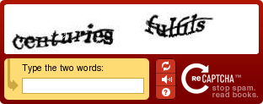
Highly non-parseable data
Entire NY Times archive (since 1851) digitized as of 2015
Notes:
State-of-the-art OCR can’t do it
But humans can, so use it as a test of whether user is a human
(CAPTCHA = Completely Automated Public Turing test to tell Computers and Humans Apart)
Beauty: two birds with one stone: test + data
And when the system is compromised, everyone wins: OCR++
EXPLAIN:
Two words, one with known ground truth

Slide 58
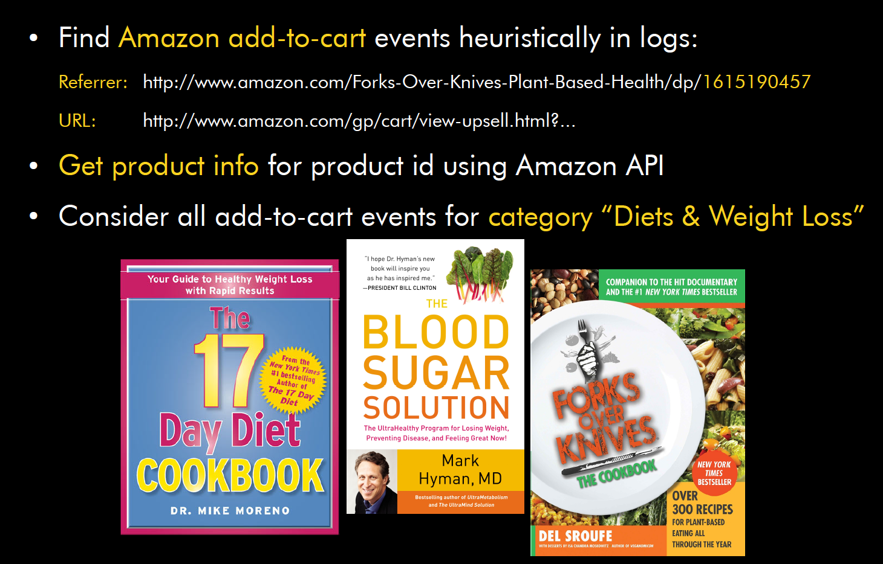
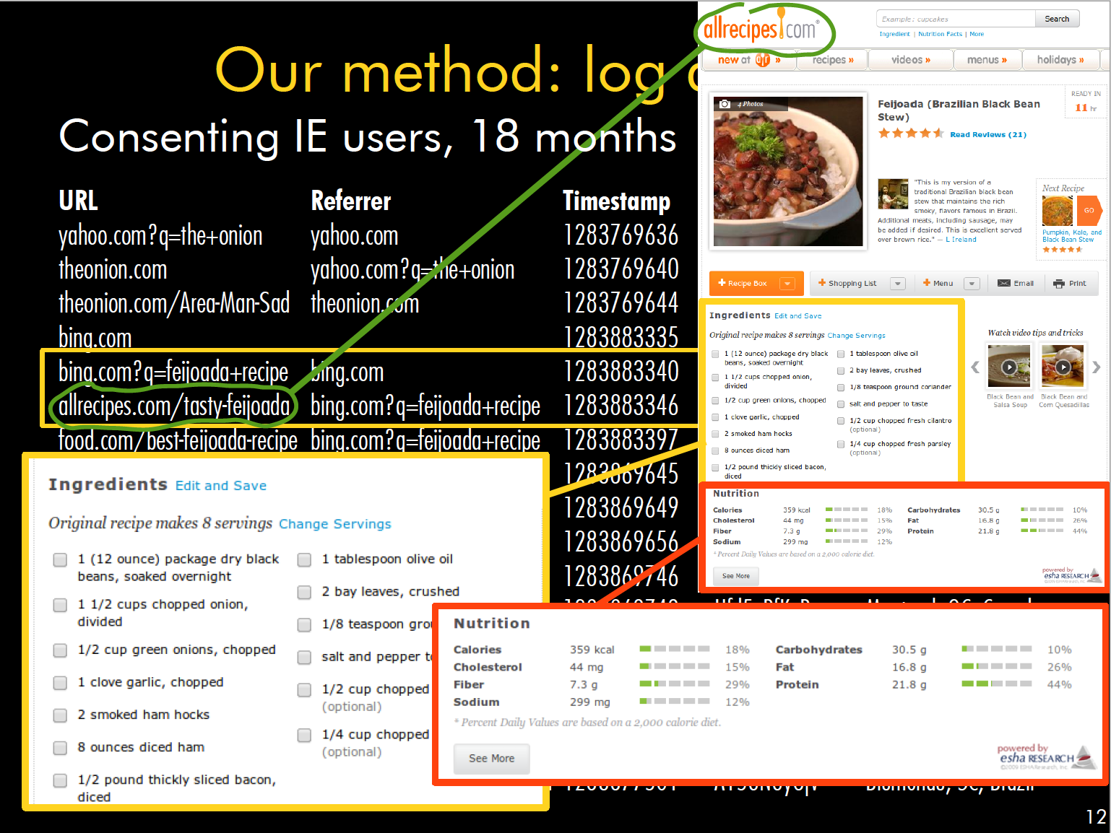
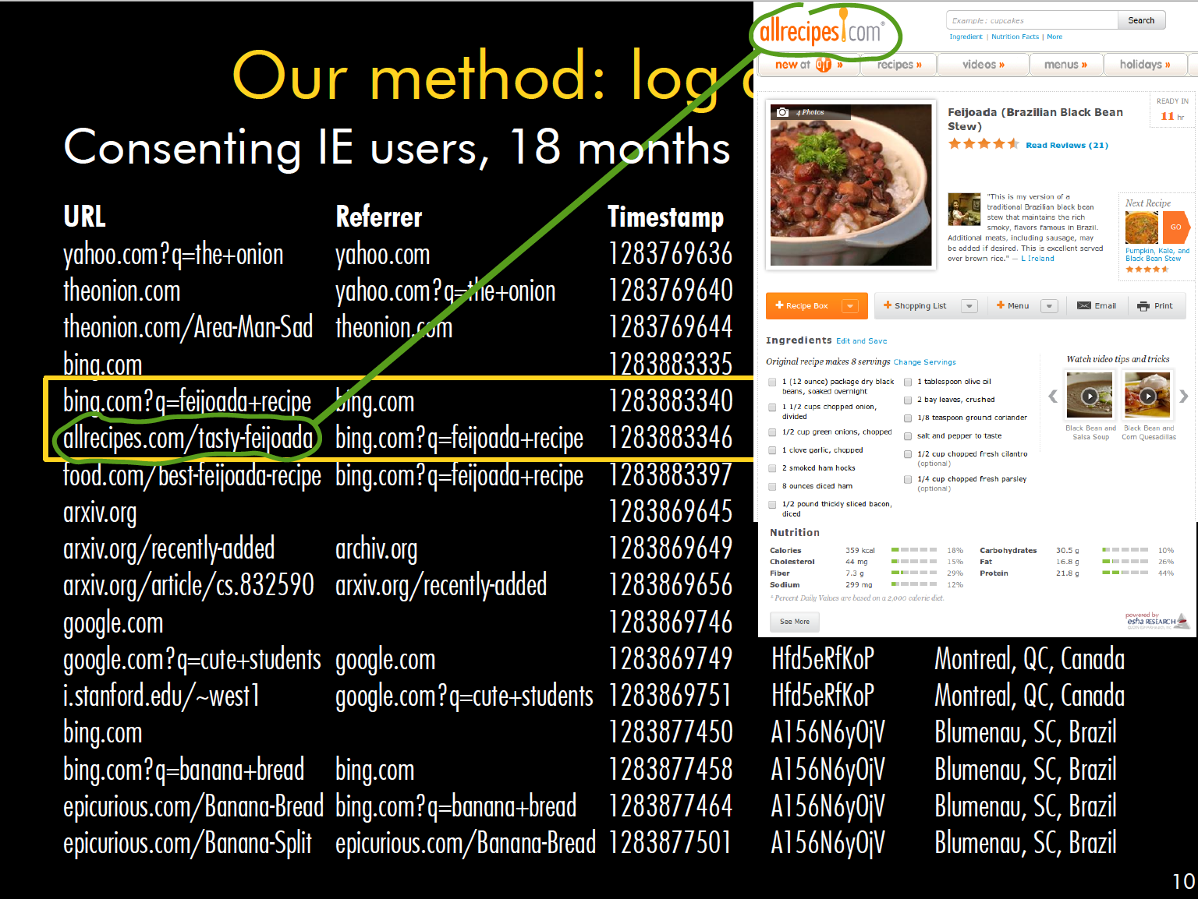
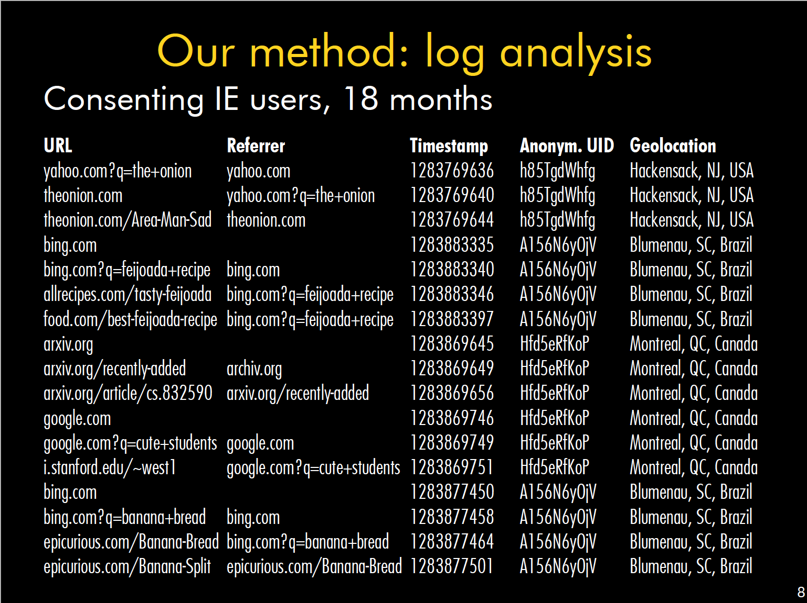
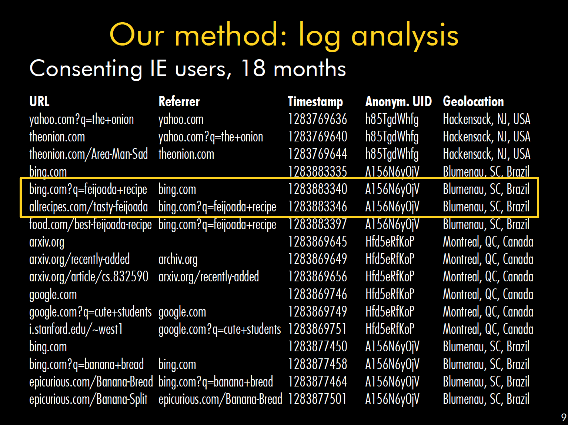
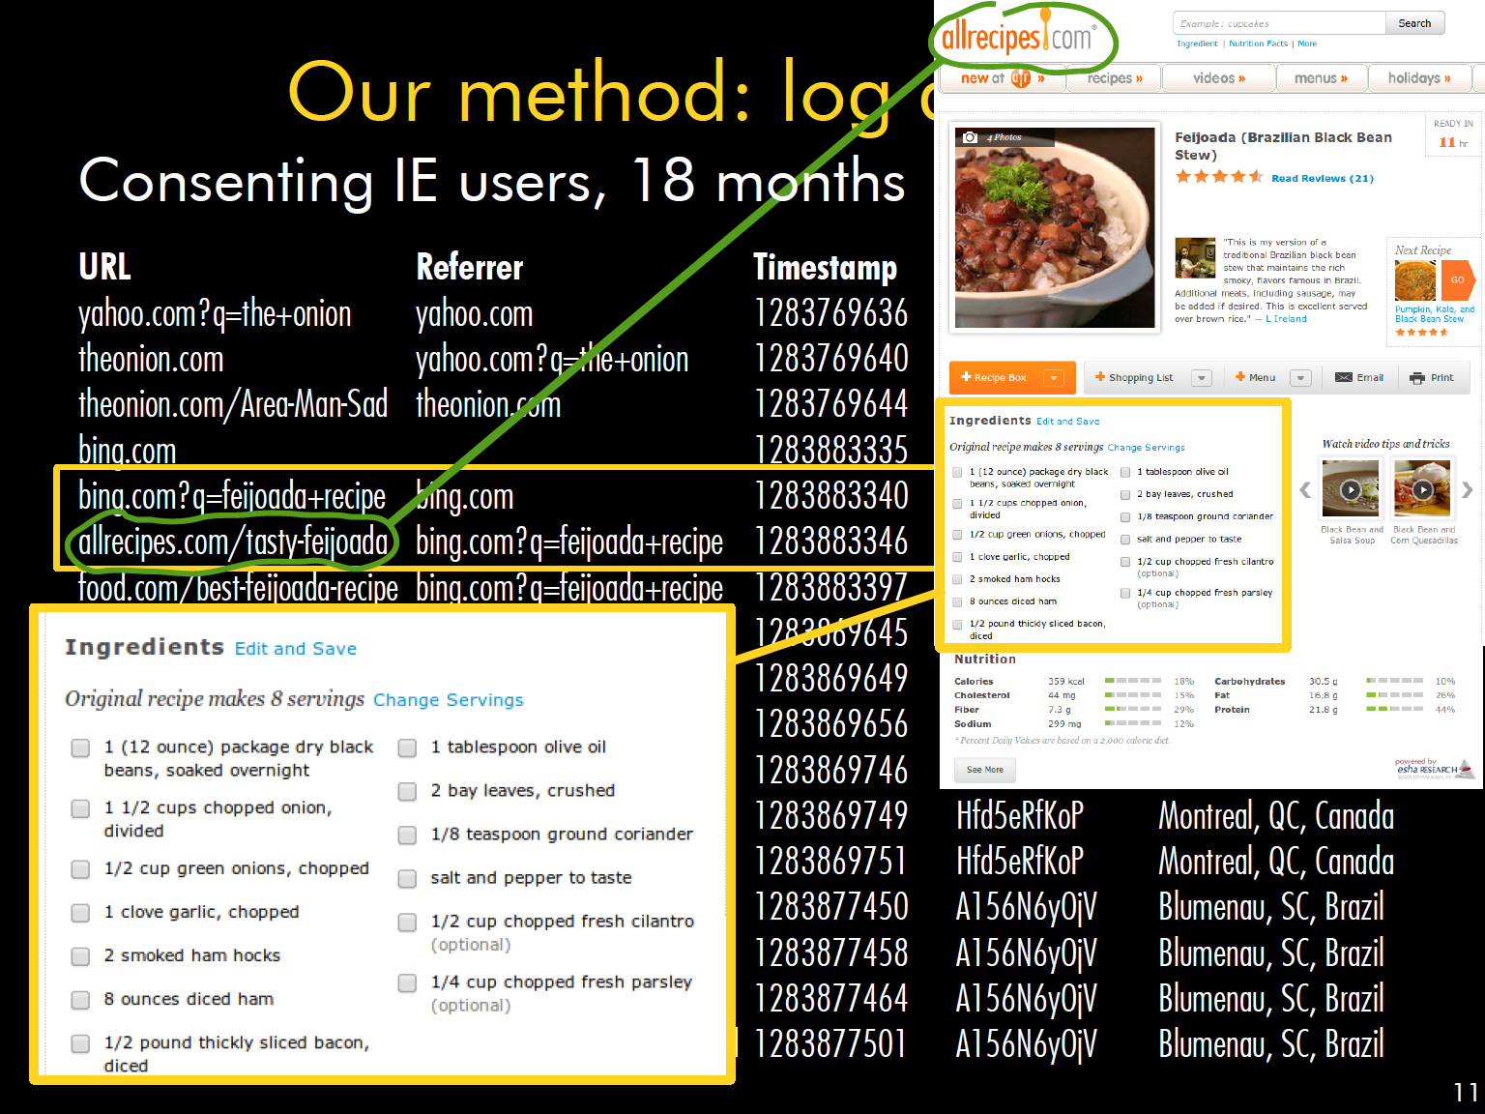

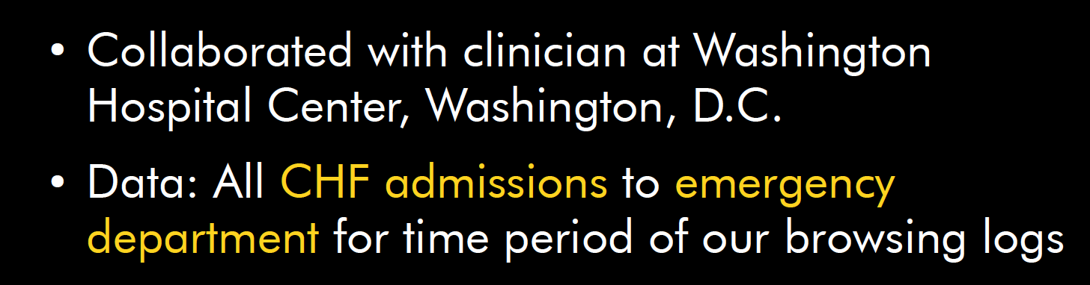
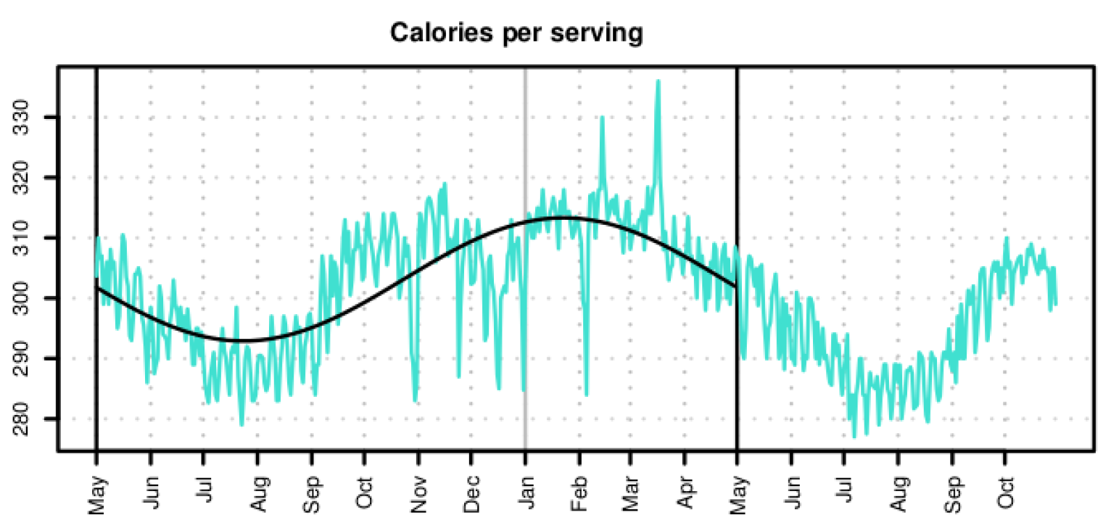
Example from Bob’s research (AD 2013)
Q: What do people eat when and where?
Paper with results and plots

Slide 59
Feedback
Give us feedback on this lecture here: https://go.epfl.ch/ada2020-lec2-feedback
Feedback form available for each lecture and lab session
What did you (not) like about this lecture?
What was (not) well explained?
On what would you like more (fewer) details?
Is it nicer to follow the lecture online or offline?
…

